Slide 1
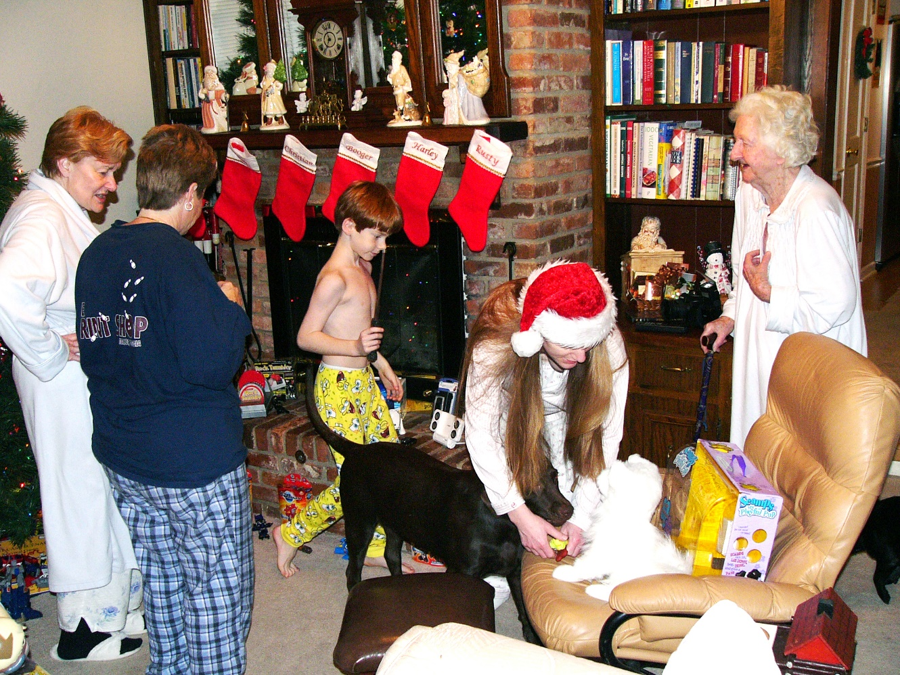
Multi-Generational Giving
Notes:
We are at a unique point in time because we are living with people from 5 different generations! Why is knowing about generations important to us in stewardship? Gaining understanding of different generational traits is critical because churches\ need to know how people of certain ages give and through what mode they typically support charities. Building trust across generations is established and maintained through an understanding of who they are, what they value, and how you communicate your message. It will boost morale, increase productivity, and build confidence. Trust is your greatest asset when it comes to the future of your church.
Granny 94
Me 33
Deborah 44
Mom 62
Christian 8
***

Slide 2
bingo
Notes:
Let’s play generational bingo. You may only get one block from any one person initialed off; five in a row is a bingo. Get up and get going.

Slide 3
Watched the Beatles on “The Ed Sullivan Show” | Waited in line to buy gas during OPEC embargo | Is on Tiktok | Has played more than 500 hours of Nintendo | Used a computer by age 10
Attended a day care center or kindergarten | Remembers when milk cost less than a dollar | Typed copy using carbon paper | Watched first-run episodes of “Gunsmoke” | Used a cell phone before the age of 20
Has never owned a record player | Watched first-run episodes of “Happy Days” | Can name three members of the Brat Pack | Knows who Zac Ephron is | Can name three members of the Rat Pack
Has own website or blog | Knows who Bing Crosby is | Watched the Who Shot JR? episode of “Dallas” | Remembers the moon landing | Watched “Sesame Street” as a child
Has parents who are divorced | Turned 30 before AIDS was identified | Listened to “The Lone Ranger” show on the radio | First voted at the age of 18 | Does not have a land line (phone)

Slide 4
1922 - 1944
traditionalist
Notes:
Starting with the traditionalist. This is our oldest living generation. They were born between 1922 and 1944. So we are talking about people who are currently between the ages of 78 and 100 years old.

Slide 5
Traditionalist 1922 - 1944
Children or young adults during Depression, WWII; after the war, settled down in prosperity
Value teamwork, conformity, respect for authority, hierarchy, fair play, honor
Take religious obligations seriously
Enjoy building for posterity
Value fair play, tolerance, compromise
Preference for relational consensus building
Notes:
Children or young adults during Depression, WWII; after the war, settled down in prosperity
Value teamwork, conformity, respect for authority, hierarchy, fair play, honor
Take religious obligations seriously
Enjoy building for posterity
Value fair play, tolerance, compromise
Preference for relational consensus building

Slide 6
Traditionalist 1922 - 1944
Many are comfortably retired
Especially value relationships and friendships
Enjoy members of other generations
Value helping hands for marginalized
Modest, giving is often quiet
Value support of arts and outreach
Are the most religious,
Notes:
Many are comfortably retired
Especially value relationships and friendships
Enjoy members of other generations
Value helping hands for marginalized
Modest, giving is often quiet
Value support of arts and outreach
are the most religious, with 89% aligning themselves with a particular religion. As most of them are retired, they are a rich source of estate gifts and ongoing contributions.

Slide 7
1945 - 1960
baby boomers
Notes:
Now let’s look at the Baby Boomers. Baby Boomers were born between 1945 and 1960, so we are talking about people who are currently between 62 and 77 years old.

Slide 8
Baby Boomers 1945 - 1960
Connect with and respond to credibility.
Trust established by credible and decisive messaging that lays out a plan for success.
Small talk isn’t just small talk.
Checking in with them builds trust and credibility.
Notes:
Baby Boomers connect with and respond to credibility. They came of age at a time when Walter Cronkite was the most trusted man in America. As national challenges arose, from the Cuban Missile Crisis to the Kennedy assassination and Vietnam war, he provided a credible and confident voice that helped them persevere with optimism through adversity.
This is precisely what Boomers respond to today during turbulent times. Trust is established when leaders provide credible and decisive messaging that lays out a plan for success. Make sure your parishioners know you’re doing everything you can to navigate the challenges ahead.
And remember, for Boomers, small talk isn’t small.
Keep in touch with your parishioners. Ask how they’re doing and see if there is anything you can do to help them as they make their way through the new world.
For Boomers, a check-in builds trust and credibility. It can go a long way and pay off big time when it comes to retaining their support.

Slide 9
Baby Boomers 1945 - 1960
Want to know your finance structure, mission, and ability for lasting change.
Typically give to religion and social services.
Two-career families with older/grown children.
Hard-working with complex schedules
Time is more precious than money
Notes:
Before donating, baby boomers want to know the organizational finance structure, organizational mission and its ability for lasting change.
They typically give to religion and social services.
Two-career families with older/grown children
Hard-working, complex schedules
Time is more precious than money

Slide 10
1961 - 1980
generation X
Notes:
The next is Generation X. Gen Xers were born between 1961 and 1980. This means they are currently between 42 and 61 years old.

Slide 11
Generation X 1961 - 1980
“Sandwiched” Generation – do most of the caregiving for children and aging parents.
Came of age as latchkey kids, children of divorce; learned how to fend for themselves
Explosion of the media (23,000 hours of TV)
Cable TV constant exposure to scandals and crises.
Institutions seen through a new lens.
Notes:
Generation Xers find themselves the new “sandwiched” generation. Studies show that Gen Xers, women in particular, do most of the caregiving for children and aging parents. Factor in the fragility of the workplace and marketplace right now, and you have a generation that is growing more skeptical by the day; however, that skeptical outlook started long before the coronavirus.
Generation X’s came of age as latchkey kids, children of divorce; learned how to fend for themselves.
Their formative years were shaped by the explosion of, and their subsequent consumption of, the media. On average, Gen Xers watched 23,000 hours of television during their formative years. Unlike the Boomers before them, cable TV and 24-hour news offered constant exposure to scandals and crises. From the AIDS epidemic, political and celebrity scandals, to economic hardships like the dotcom bust, Xers had a front row seat and a peak behind the curtain of institutions that were being seen through a different lens. News came from cable TV pundits rather than Walter Cronkite, and trust in institutions began to erode.

Slide 12
Generation X 1961 - 1980
Distrust of institutions and authority – want authenticity, not sugar coating
Share what you know, admit what you don’t know.
Often have little religious background – need religious education
Transparency builds trust.
Notes:
As a result, Gen Xers are very skeptical by nature, often questioning most of what they’re told, even by those in positions of authority (sometimes even more so). Don’t blow smoke, and be honest about difficult situations. Share what you know, admit what you don’t know. (Do we need to cut expenses?). Don’t be grim, but don’t paint a picture that isn’t truthful.
Often have little religious background or coherence – need religious education (Adult Christian Formation, Instructed Eucharists)

Slide 13
1981 - 2000
millennials/gen Y
Notes:
Next are the Millennials – also called Generation Y. The Millennials were born between 1981 and 2000, making them currently between 22 and 41 years old.

Slide 14
Millennials 1981 - 2000
Unluckiest Generation – Columbine, 9/11, 2008 recession, COVID-19, tremendous student debt.
Lots of uncertainty. Does not trust easily.
1st generation to grow up in the age of social media.
Constant access to real-time information.
Shared thoughts/expressed themselves to a wide audience at an early age.
Born at time of rekindled interest in children – emphasis on protection, safety, health
Rules, respect, responsibility, right and wrong
Teamwork, problem-solving
Powerful, capable, competent achievers
Notes:
The Washington Post made the case that Millennials are America’s “unluckiest generation.” Born in the early 1980s, they came up during a time of tremendous turmoil. From the Columbine school shooting, the September 11th terrorist attacks, and the 2008 recession, the COVID-19 pandemic is certainly not the first time this generation has had to deal with uncertainty. Combined with the fact that Millennials have had to contend with tremendous student loan debt, and you have a generation that does not trust easily.
Being the first generation to grow up in the age of social media, Millennials have had constant access to information in real-time. They grew accustomed to sharing their thoughts and expressing themselves to a wide audience at an early age.

Slide 15
Millennials 1981 - 2000
Columbine inspired a change in educational system
Guidance counselors added to schools across the country to help foster collaborative classroom interactions
Able to participate in authentic, open dialogue with teachers, parents, and other authority figures from a young age.
Created a new precedent for how leaders are expected to communicate with this generation.
Born at time of rekindled interest in children – emphasis on protection, safety, health
Rules, respect, responsibility, right and wrong
Teamwork, problem-solving
Powerful, capable, competent achievers
Notes:
Add to that, the Columbine tragedy inspired a change in our educational system, adding guidance counselors to schools across the country to help foster collaborative classroom interactions. Millennials were then able to participate in authentic, open dialogue with teachers, parents, and other authority figures from a young age.
Now that they’re fully grown and in the workforce, this has created a new precedent for how leaders are expected to communicate with this generation. The days of “I say ‘jump,’ you say ‘how high?’” are far behind us. Millennials expect more; they want a “why?”

Slide 16
Millennials 1981 - 2000
Millennials expect more; they want a “why?”
Take religious obligations seriously
Desire order, hierarchy, tradition
Strong sense of responsibility, right/wrong
Yearning for calm inner world
Put their trust in organizations who create channels for open, authentic, collaborative conversations.
Notes:
Millennials expect more, they want a “why”
Take religious obligations seriously
Desire order, hierarchy, tradition – They don’t want praise bands, they want ancient Celtic Services, Taize.
Strong sense of responsibility, right and wrong
Yearning for calm inner world
Millennials put their trust in organizations who create channels for open, authentic, collaborative conversations—not lectures and memos about new policies and procedures.
Fun fact: More professional Millennials have an MBA than have no higher education at all.

Slide 17
2001 - current
generation Z
Notes:
The last generation is Generation Z. Generation Z includes those who are currently infants up to 21 years old.
Gen Z’s formative years were significantly different from Millennials. They have never known a world without Google. They never experienced dial-up internet. They have no memories of 9/11 or Columbine. Their formative years were, however, shaped primarily by tragedy. The War on Terror, gun violence, global warming, recession, and disease were experienced long before this generation set foot in the workplace.

Slide 18
Gen Z / iGeneration 2001 -
91% stress related anxiety/depression
Provide tools/resources to manage stress and mental health to establish and maintain trust
Highly motivated to support philanthropic causes
Motivated by having relationships with leaders and volunteers
Social causes plus data driven resulting in a better world
Notes:
Not surprisingly, Gen Z has reported high levels of stress and anxiety at a very young age. In fact, the American Psychological Association found that 91% of Gen Z said they had felt physical or emotional symptoms, such as depression or anxiety, associated with stress. Now, in the infancy of their careers, this global pandemic will no doubt feed into that.
Providing Gen Z with the tools and resources to manage stress and support their mental health is your best approach for establishing and maintaining their trust right now. That trust is best cultivated when organizations demonstrate they value people as much as profit.
Generation Z is highly motivated to support philanthropic causes. They see it as an important part of their identity! Like their Millennial counterparts, they are motivated by having relationships with the leaders and volunteers.
Generation Z is interested in social causes plus data driven resulting in a better world.

Slide 19
Gen Z / iGeneration 2001 -
More concerned with cause than organization
Computer Savvy
Research topics and organizations that interest/inspire them.
Inspired by news & social media reports about impact.
Very aware of marketing tactics and sniff out insincerity
Majority non-white by 2026
Notes:
Generation Z is passionate about supporting nonprofits, but that doesn’t mean they’re passionate about giving to one specific organization. They’re more concerned with causes! They are much more concerned about and interested in a cause than an organization.
Average GenZ-er received their first cellphone at 10 years old, so they are very computer savvy and they are willing and able to use their computer to research the topics and organizations that interest and inspire them. When they’re trying to decide if they want to make a gift, they’ll be inspired to give by news outlets and other media reports about impact.
But be careful, they’re very aware of marketing tactics and can sniff out insincerity without trying. (They have highly evolved BS Detectors)
Demographically, Gen Z is predicted to be majority non-white by 2026
Generation Z may be a young generation, but they’re already making an impression on the nonprofit world. They’re passionate about making a difference in the world, and they’re ready to support the causes that inspire them. They don’t have the spending power enjoyed by the older generations, but they’re already actively involved in donating to nonprofits.

Slide 20
Views
Notes:
Now let’s look at how the views of the generations differ.

Slide 21
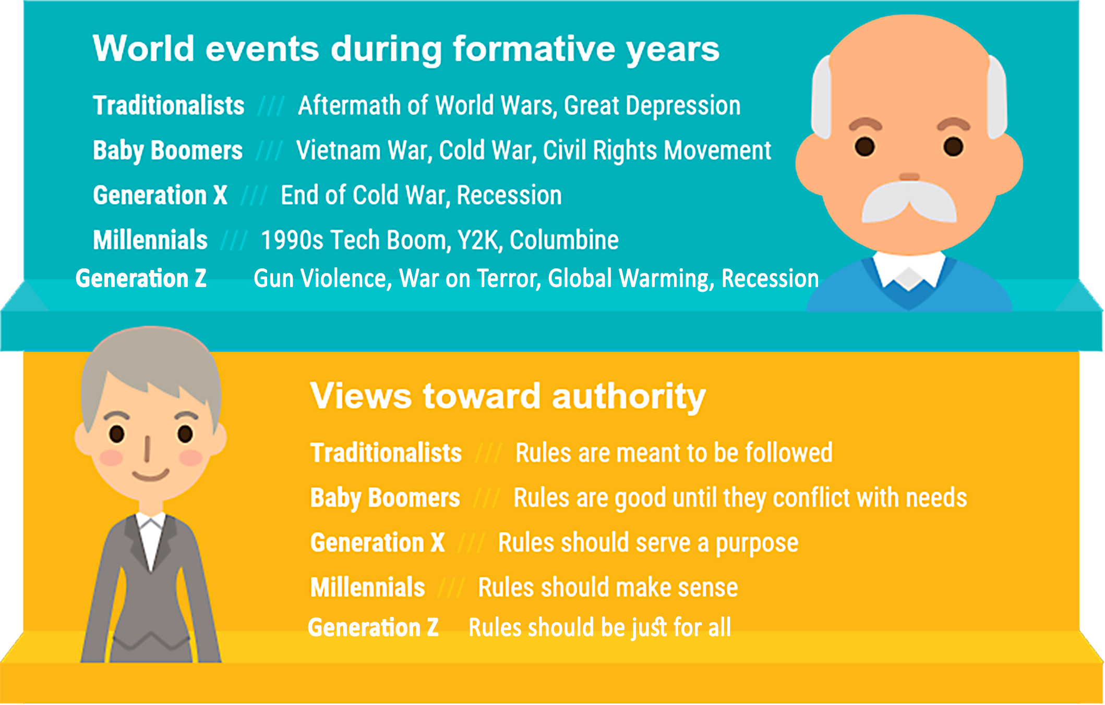
Train them too much & they will leave
The more they learn, the more they will stay
Continuous learning is a way of life
Notes:
World events during formative years
Traditionalist: Aftermath of World Wars, Great Depression
Baby Boomers: Vietnam War, Cold War, Civil Rights Movement
Generation X: End of Cold War, Recession
Millennials:/Gen Y: 1990’s Tech Boom, Y2K, Columbine, 9/11
Generation Z: Gun violence, War on Terror, Global Warming, Recession
Views toward authority
Traditionalist: Rules are meant to be followed
Baby Boomers: Rules are good until they conflict with needs
Generation X: Rules should serve a purpose
Millennials:/Gen Y: Rules should make sense
Generation Z: Rules should be just

Slide 22
Train them too much & they will leave
The more they learn, the more they will stay
Continuous learning is a way of life
Notes:
Who should lead?
Traditionalist: The most senior person.
Baby Boomers: The most accomplished person
Generation X: The person who can get the job done
Millennials:/Gen Y: The person who best contributes to the group
Generation Z: The person who leads by example with integrity and transparency
Views toward work
Traditionalist: Work to live
Baby Boomers: Live to work
Generation X: Work is a means to an end
Millennials:/Gen Y: Work provides fulfillment
Generation Z: Work is meaningful

Slide 23
Train them too much & they will leave
The more they learn, the more they will stay
Continuous learning is a way of life
Notes:
Work ethic
Traditionalist: Work hard, pay dues
Baby Boomers: Career determines identity
Generation X: Need work/life balance
Millennials:/Gen Y: Seek to contribute and collaborate
Generation Z: Seek to change the world and maintain personal wellbeing
Motivating messages
Traditionalist: I value your experience
Baby Boomers: I value your accomplishments
Generation X: Do the job how you want
Millennials:/Gen Y: You are part of a dynamic team
Generation Z: You are making a difference

Slide 24
Train them too much & they will leave
The more they learn, the more they will stay
Continuous learning is a way of life
Notes:
Communication Preferences
Traditionalist: In person
Baby Boomers: Phone
Generation X: Email
Millennials:/Gen Y: Text/social media
Generation Z: Video calls/text/social media

Slide 25
Giving Patterns
Notes:
Now, let’s look at each generation’s giving patterns.

Slide 26
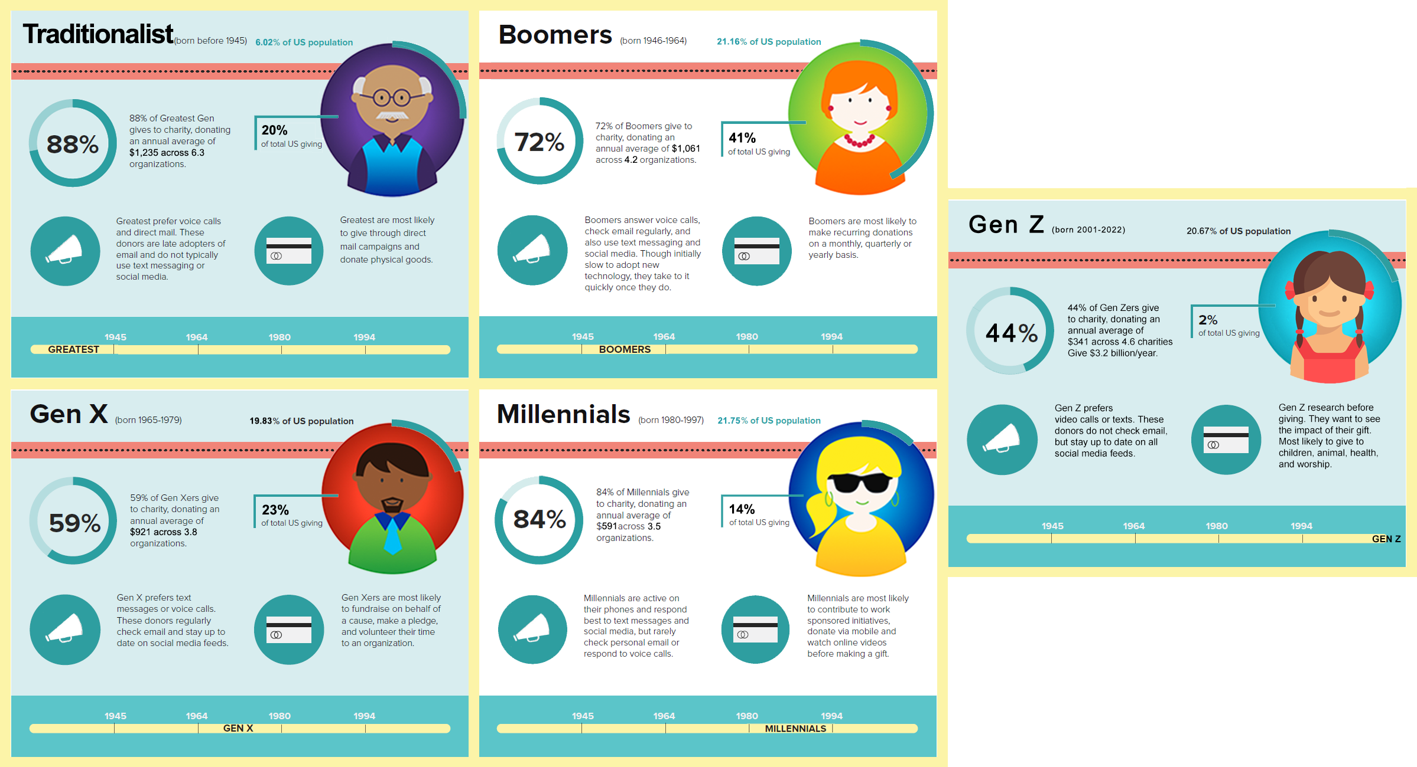
Notes:
Let’s start with the Traditionalist

Slide 27
Notes:
Traditionalist: (78 – 100 years old)
6.02% of population
88% give to charity an average of $1,235 across 6.3 organizations
Responsible for 20% of total giving (dollars)
Traditionalist give to causes they have seen or by which they have been personally touched.
They support areas such as religion and emergency relief efforts.
Prefer phone calls and direct mail – not about text messages and social media
Most likely to give through direct mail campaigns and to donate physical goods

Slide 28
Notes:
(62 – 77 yrs. old)
21.16% of population
72% give to charities an average of $1,061 across 4.2 organizations
41% of total giving
Answer voice calls, check email regularly, also use text messaging and social media. Slow to adopt new technology, but take to it quickly once they do.
Most likely to make recurring donations on a monthly, quarterly or yearly basis.
re responsible for 41% of charitable donations, with average annual contributions topping $1,000. They are more likely than younger generations to be religious but still less likely than The Silent Generation.² Because they are the generation now retiring, they may have more disposable time to volunteer. Nearly three-quarters of Boomers support charitable causes, and as the average donor sits squarely in the Boomer generation, this cohort is likely to dominate giving for a few more years.

Slide 29
Notes:
(42 - 61 years old)
19.83% of population
59% give to charity, average $921 across 3.8 organizations
23% of total giving (dollars)
Lead their generational counterparts in annual volunteer hours served.
They like to give to religion and children charities.
Prefer text messages or voice calls, check email regularly, and up to date on social media
Most likely to fundraise for a cause, make a pledge, and volunteer their time

Slide 30
Notes:
Millennials (22 - 41 years old)
21.75% of population
84% give to charity an average of $591 across 3.5 organizations
14% of total giving dollars
Nearly 75% of Millennials provided financial support to family, friends or nonprofits since the Covid-19 pandemic began — the highest rate among any generation polled.
They tend to support children’s causes and human rights movements.
Actively respond to their phones via text messages or social media, rarely check emails or respond to voice calls
Most likely to contribute to work sponsored initiatives, donate via mobile, and watch online videos before making a gift

Slide 31
Notes:
20.67% of the population
44% give to charity and average of $341 across 4.6 charities
2% of all giving
3.2 billion/year
Prefer video calls or texts. Do not check email, but constantly checking social media.
Research before giving and want to see the impact of their gift.
Most likely to give to children, animal, health, and worship
Can be incredibly powerful when they decide to raise money by influencing others through social media.
Interesting fact: Gen Z is also 16 times more amenable than the Traditionalist to give to a street canvasser.

Slide 32
Notes:
What do you notice? The Millennials are very similar to the Traditionalist.
Here’s something to keep in mind: By 2061, Generation X and millennials will inherit $59 trillion in wealth from their aging baby boomer parents. This new philanthropic power will make them the most significant donors in the history of philanthropy.

Slide 33
Strategies
Notes:
Knowing all of this, how do we tweak our approach for each generation?

Slide 34
Establish and build warm relationships: calls, lunches, occasional notes, birthday cards
Personalized donation letters
Phone calls
Know and provide budget details and goals
Physical checks for donations
Planned giving
Notes:
For the Traditionalist:
Establish and build warm relationships: calls, lunches, occasional notes, birthday cards
Personalized donation letters
Phone calls
Know and provide budget details and goals
Physical checks for donations
Planned giving

Slide 35
Prefers receiving updates and donation asks via emails
Value individuality – personalized emails are a must
Online donation with easy-to-use forms
Create a story around giving
Thanking is key
Set up recurring gifts to create continuous support
Reluctant to commit: Give them time!
Notes:
Boomers –
While we tend to think of the millennial and Gen Z generations as tech-savvy, baby boomers also have preferences for virtual communications and donations:
Email appeals. A weekly email newsletter is likely to be read by this generation, which favors receiving updates and donation asks via email. Baby boomers greatly value individuality over conformity, so personalized emails are a must!
Online donation with easy-to-use forms. While many members of this generation likely still have checkbooks, they are comfortable making online donations and sometimes even prefer it!
Create a story around your giving strategy to help attract more donors to your cause.
Thanking is key to reaching this generation.

Slide 36
Appreciate time and talent, not just treasure
Facebook peer-to-peer fundraising
Transparency
Be brief and to the point; don’t waste time
Prefer task forces to long term committees
Use web-based techniques, EFT, online giving
Purposeful, efficient communication is better than constant communication
Notes:
Gen X:
Appreciate time and talent, not just treasure – highest volunteer rates
Like to interact with giving
Facebook peer-to-peer fundraising - more than 88% of Generation X is on Facebook, peer-to-peer fundraisers hosted on Facebook can be very effective with this generation.
Transparency -This generation is willing to volunteer their time and donate their money, but they want to know what is being done with their contributions. Building trust through effective communication is key.
Be brief and to the point; don’t waste time
Use web-based techniques, EFT, online giving
Prefer task forces to long term committees
For Xers, transparency builds trust. Make your communication with Xers as transparent as possible. Moreover, your Xer will appreciate efficient communication now more than ever. As they continue working to keep their own lives intact, be a resource to them, not a bother. For self-sufficient Xers, purposeful communication is a better approach than constant communication.

Slide 37
Next Gen Donors
Notes:
Next Gen donors are millennials and Gen Z collectively.
Both the millennial and Gen Z generations gave more than any other generation during the pandemic, demonstrating both the economic power and expansive generosity of this younger age group. How the next-gen responded was not a one-time reaction. Philanthropy and traditional giving will not “return to normal.” Instead, we will be required to shift toward a more tech-savvy, yet secure method of reaching a younger population.

Slide 38
Look for hands-on engagement
Don’t want recurring annual donations
Want to feel like they’re in the room where decisions are being made
Want to be integral part of achieving social impact
Drawn to causes that inspire and invite their full engagement
Give when inspired
Notes:
Younger donors look for hands-on engagement and involvement with the organizations they support.
They aren’t satisfied with a recurring annual donation to a cause they aren’t involved in.
Want to feel like they’re in the room where decisions are being made.
Want to be an integral part of achieving social impact
Drawn to social causes that inspire and invite their full engagement. Next-gens tend to integrate philanthropy into all aspects of their lives.
Give when they feel inspired by an organization. This means don’t shy away from bold views. Share your stance on social issues with specific examples of what you’re doing to advance progress. Remember, young givers want to get behind a cause that is meaningful to them.

Slide 39
To attract / inspire Next Gen:
Build relationships with local news outlets
Emphasize donor impact on social media – STAY ACTIVE!
Want to donate quickly and easily
Add donate button/link to social media posts
Create texting giving keyword
Notes:
***
If you’re looking to attract and inspire donors from this generation, build relationships with local news outlets and put an emphasis on sharing donor impact on your social media channels. This generation wants to know that their support will help change the world; you need to make a concerted effort to show them! Center your church’s narrative in human terms through written word, videos and images. If next-gen donors see themselves or someone they know as being affected by a cause, they will have a higher propensity to take action.
Poor social media presence is the #1 reason someone from this generation will decide not to donate, so stay active.
Once they decide to make a gift, they want to donate quickly and easily. 32.6% of them are most likely to want to give as a result of social media posts, so explore adding a donate button or link to your donation form to your posts. 29.1% of them want to donate via a text message or app, so consider creating a text giving keyword they can use to make a gift on their phones.

Slide 40
How to keep
Build personal relationships that inspire them to stay engaged; pair with a mentor
Show them they’re making a difference in the world with frequent updates
40% want monthly updates
Stories about the people they helped and how their money was used
Prefer to see updates on social media, but they do appreciate personal phone calls (video calls).
Notes:
If you want to keep Next Gen donors engaged on a regular basis, you’ll want to build personal relationships with them that will inspire them to stay engaged, pair them with a mentor.
And you’ll need to show them that they’re actually making a difference in the world. They want to see the impact of their support first-hand and review data that shows the success (or lack thereof) of a program or organization. Need to provide transparency in linking charitable contributions to measurable results.
Since this group of donors is most motivated by making an impact on the causes that inspire them, they want to stay in touch with the organizations they support. They prefer more frequent updates than any of the other generations: 40.7% of them want monthly updates! They’re most interested in receiving updates containing stories about the people they helped and about how their money was used. Generally, they prefer to see updates on social media, but they do appreciate personal phone calls (remember how they’re motivated by personal relationships?).

Slide 41
Give them non-financial ways to support your work
82.4% are willing to raise money for their favorite organizations by asking friends and family for support
Peer-to-peer fundraisers
Invite them to collect donations to mark milestone occasions like birthdays and graduations
Encourage them to share their content to their social networks
Notes:
Another way to keep Next Gen involved with your church by giving them non-financial ways to support your work. They’re very willing to raise money for their favorite organizations by asking friends and family for support (82.4% are willing to do so). Ask them to participate in a peer-to-peer fundraiser, invite them to collect donations to mark milestone occasions like birthdays and graduations, or
encourage them to share their content to their social networks. Younger generations place a priority on sharing knowledge, and their philanthropy is no exception. Next-gens will share their experience with organizations on social media, making them valued ambassadors for churches that have long struggled to get their messages out. 24% have donated after learning about a cause on social media.
They want to help—give them ways to do so!

Slide 42
Reasons for stopping long-term support:
Could no longer afford to give
Did not receive updates about how their money was used
They were never asked to give again
Notes:
Understanding their impact is the best way to keep Generation Z donors engaged with your church. 62.4% of them have stopped long-term support of their favorite nonprofits, and they have some really interesting reasons for ending those relationships. The most common one was that they could no longer afford to give. That isn’t particularly surprising—many of these donors are students who are either new to the workforce or have not yet finished school! The next most common reasons for ceasing their support is that they either received no updates about how their money was used or were simply never asked to give again.
Many believe that it’s up to their generation to drive giving to be more impactful, engaged and connected.
The drive to innovate, solve real-world problems and ensure that giving time and resources are being put to best effect will be game-changers for leaders seeking to accelerate the impact of their work.
Younger generations are shaping a new course for philanthropy. They will likely continue to challenge convention and historical practices, raising the bar from charitable giving to charitable living.

Slide 43
tammypallot@gmail.com
Tammy Pallot
Notes:
***Wrap Up:
All these generations can be engaged inside your faith community by focusing on their interests.
Gen Z want to know where faith fits into their lives and can be engaged in service and social justice. Millennials are the loneliest generation because they are glued to their phones and need faith to fill the void. Offer them opportunities to be part of a community that is larger than themselves and engage them with the personal connections that technology can’t give them.
Gen Xers are juggling mid-life issues and
Boomers are the powerhouse donors to faith communities.
The Traditionalist are about legacy gifts and may be looking at their faith community as a place where their strength has been rooted.
******************
Extra info: (41%) say they would not donate to a charity they supported in the past upon learning that the charity tolerates discrimination. By comparison, 34% would not donate to charities using culturally insensitive images and language, and 17% would not donate upon learning the charity’s board is not diverse.
Gen Z majority non-white by 2026

